Slide 1
The Scene Analysis

Slide 2
What is in the Scene Analysis?
March 18th, 4:00pm-4:50pm
Lecture at 5pm
Two clips from films watched in class (Weeks 1-6, Citizen Kane and before)
Define the Narrative Function the shown scene in essay format

Slide 3
What is Narrative Function?
Advance the plot
Turning points
How does the scene advance the plot? If it’s a turning point, Which act does the scene lead from and to?
Provide character information that bears upon the plot or story
What does the scene tell us about the character? Why is this important to the plot? Does it lead to the film’s climax?
Thematic Information
In relation to the plot
What does the scene tell about the central themes of the film?
What is the theme?

Slide 4
How should the Essay be Set up?
INTRODUCTION
Opening statement, mention the film’s title, director, and year of release (being one year off will be a half mark)
State the narrative function of the scene
State a thesis that identifies three specific devices of film style that influences the narrative function
“This narrative function is conveyed through the stylistic devices of x,y, and z”
PARAGRAPH ONE
The first example, and provide an example from your chosen scene
PARAGRAPH TWO
The second example, etc.
PARAGRAPH THREE
The last example, etc.
CONCLUSION
Restate the thesis, provide any last insights to tie it up

Slide 5
Preparations
Be sure to have seen Singin’ in the Rain, Casablanca, Do the Right Thing, Rear Window, M, and Citizen Kane so you can identify the narrative function from any scene in the film’s narrative structure
Ask
How does this scene fit into the plot’s structure?
What does the scene tell us about the characters?
Why is that information important to the plot?
Brush up on Vocabulary terms introduced in week one of class
Develop good study habits!

Slide 6
Tips for studying
Try writing down the content by hand
Studies show that information is more easily remembered when written down
I usually compress all the most important information into one document and then rewrite it all by hand
Study before bed, over multiple nights
When information is freshly in short term memory, your brain is more likely to put that information into long term memory while you sleep rather than forgetting it
DO NOT cram study right before/day of exam
On average, short term memory can hold 7-10 different pieces of information, then it is sorted into long term or discarded if new information comes in before the sorting
If you overload your short term memory you’ll remember very few things compared to what you studied
Be careful when studying with friends, they’re there to help and study themselves but they also represent a distraction
When in groups, maybe split up the subjects and make a study guide together!
Pace yourself! Take breaks! 40 minutes of studying and 20 minutes of break every hour!
Or the Pomodoro Method. Set a 25 minute timer, take a 5 minute break, every fourth take 15-30 min
Give yourself an incentive! Small treats, Chicken Nuggies, a little thing from Amazon, etc.
Drink water! A hydrated mind works better than a dehydrated one!

Slide 7
What the hell is a thesis?
The core argument of the essay
Without a proper thesis your essay goes nowhere

Slide 8
How to write a thesis?
Three types of theses
Analytical - breaks down an idea into component parts
Expository - explains something to the reader
Argumentative - makes a claim about a topic and justifies it with evidence
The life of the typical college student is characterized by time spent studying, attending class, and socializing with peers.
High school graduates should be required to take a year off to pursue community service projects before entering college in order to increase their maturity and global awareness.
An analysis of the college admission process reveals one challenge facing counselors: accepting students with high test scores or students with strong extracurricular backgrounds.

Slide 9
A Good example of a film thesis
In this scene, bright costumes, high-key lighting, and camera angles contribute to the characterization of Don as a superficial person. This characterization is important ot the plot because Don’s transformation from superficial celebrity to a trustworthy person helps him to attain one of his goals: a romantic union with Kathy.
What kind of thesis is this?
This is the kind of thesis you want for the scene analysis

Slide 10
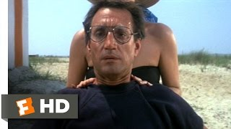
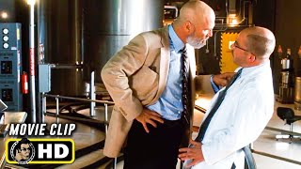
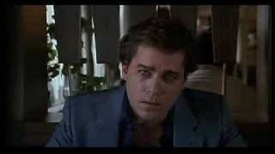
Who do I do?
Make sure your thesis is concise, contentious, and coherent
So let’s practice
Make a thesis that defines the narrative function from one of these scenes

